Slide 1
B-Trees
Dr. Ashish Sharma

Slide 2
Properties
A B-tree T is a rooted tree (with root root[T]) having the following properties.
Every node x has the following fields:
  a. n[x], the number of keys currently stored in node x,
  b. the n[x] keys themselves, stored in nondecreasing order: key₁[x] ≤ key₂[x] ≤ ……. ≤ key_{n}[x][x], and
  c. leaf [x], a boolean value that is TRUE if x is a leaf and FALSE if x is an internal node.

Slide 3
Cont…
2. If x is an internal node, it also contains n[x] + 1 pointers c₁[x], c₂[x], . . . , c_{n}[x]+1[x] to its children. Leaf nodes have no children, so their c_{i} fields are undefined.
3. The keys key_{i}[x] separate the ranges of keys stored in each subtree: if k_{i} is any key stored in the subtree with root c_{i}[x], then
k₁ ≤ key₁[x] ≤ k₂ key₂[x] ≤ ….. ≤ key_{n[x]}[x] k_{n}[x]+1 .
4. Every leaf has the same depth, which is the tree's height h.
David Luebke <number> 11/07/26

Slide 4
Cont…
5. There are lower and upper bounds on the number of keys a node can contain. These bounds can be expressed in terms of a fixed integer t ≥ 2 called the minimum degree of the B-tree:
a. Every node other than the root must have at least t - 1 keys. Every internal node other than the root thus has at least t children. If the tree is nonempty, the root must have at least one key.
b. Every node can contain at most 2t - 1 keys. Therefore, an internal node can have at most 2t children. We say that a node is full if it contains exactly 2t - 1 keys.
David Luebke <number> 11/07/26

Slide 5
Cont…
The simplest B-tree occurs when t = 2. Every internal node then has either 2, 3, or 4 children, and we have a 2-3-4 tree. In practice, however, much larger values of t are typically used.
David Luebke <number> 11/07/26

Slide 6

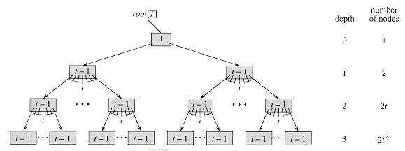
Theorem : If n ≥ 1, then for any n-key B-tree T of height h and minimum degree t ≥ 2, then
David Luebke <number> 11/07/26

Slide 7
Cont…
Proof If a B-tree has height h, the number of its nodes is minimized when the root contains one key and all other nodes contain t - 1 keys.
In this case, there are 2 nodes at depth 1, 2t nodes at depth 2, 2t² nodes at depth 3, and so on, until at depth h there are 2t^{h-}1 nodes.
Figure illustrates such a tree for h = 3. Thus, the number n of keys satisfies the inequality
David Luebke <number> 11/07/26

Slide 8
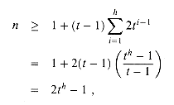
Cont…
David Luebke <number> 11/07/26

Slide 9
B-TREE-SPLIT-CHILD(x,i,y)
1 z ←ALLOCATE-NODE()
2 leaf[z] ← leaf[y]
3 n[z] ← t - 1
4 for j ←1 to t - 1
5 do key^{j}[z] ← key^{j}₊^{t}[y]
6 if not leaf [y]
7 then for j ←1 to t
8 do c_{j}[z] ← c_{j+t}[y]
9 n[y] ← t - 1
David Luebke <number> 11/07/26

Slide 10
B-TREE-SPLIT-CHILD(x,i,y)
10 for j ←n[x] + 1 downto i + 1
11 do c_{j+1}[x] ←c_{j}[x]
12 c_{i}+1[x] ←z
13 for j ← n[x] downto i
14 do key_{j+1}[x] ← key_{j}[x]
15 key_{i}[x] ← key_{t}[y]
16 n[x] ←n[x] + 1
17 DISK-WRITE(y)
18 DISK-WRITE(z)
19 DISK-WRITE(x)
David Luebke <number> 11/07/26

Slide 11
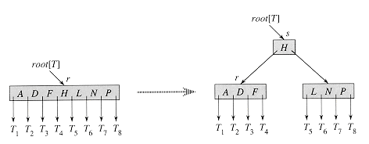
Spliting a node in B-Tree
David Luebke <number> 11/07/26

Slide 12
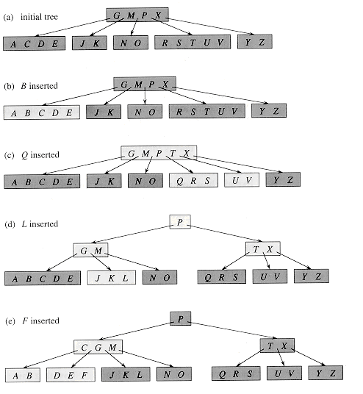
Example
t=3
so a node can hold at most 5 keys
David Luebke <number> 11/07/26

Slide 13

Let us understand the algorithm with an example tree of minimum degree ‘t’ as 3 and a sequence of integers
10, 20, 30, 40, 50, 60, 70, 80 and 90 in an initially empty B-Tree.
Initially root is NULL. Let us first insert 10.
David Luebke <number> 11/07/26

Slide 14
Let us now insert 20, 30, 40 and 50. They all will be inserted in root because the maximum number of keys a node can accommodate is 2*t – 1 which is 5.
David Luebke <number> 11/07/26

Slide 15

Let us now insert 20, 30, 40 and 50. They all will be inserted in root because the maximum number of keys a node can accommodate is 2*t – 1 which is 5.
David Luebke <number> 11/07/26

Slide 16
Let us now insert 60. Since root node is full, it will first split into two, then 60 will be inserted into the appropriate child.
David Luebke <number> 11/07/26

Slide 17
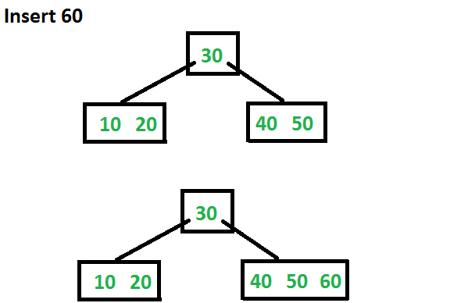
Let us now insert 60. Since root node is full, it will first split into two, then 60 will be inserted into the appropriate child.
David Luebke <number> 11/07/26

Slide 18
Let us now insert 70 and 80. These new keys will be inserted into the appropriate leaf without any split.
David Luebke <number> 11/07/26

Slide 19
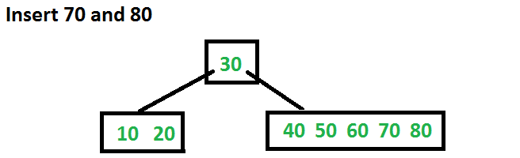
Let us now insert 70 and 80. These new keys will be inserted into the appropriate leaf without any split.
David Luebke <number> 11/07/26

Slide 20
Let us now insert 90. This insertion will cause a split. The middle key will go up to the parent.
David Luebke <number> 11/07/26

Slide 21
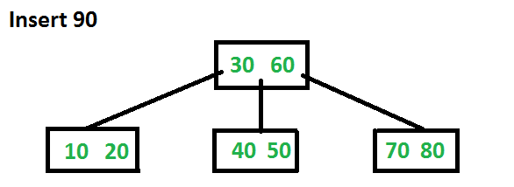
Let us now insert 90. This insertion will cause a split. The middle key will go up to the parent.
David Luebke <number> 11/07/26

